Slide 1

Acercamiento a Rol Consultor Ciencia de Datos
Por: Jorge Forero L.

Slide 2
Tabla de Contenidos
No
Agenda para hoy.
Página
01.
Generalidades del Estudio
2
02.
Hallazgos del EDA y Distribuciones
9
03.
Clustering y Atributos Clave
17
04.
Modelos Predictivos y Performance
21
05.
Recomendaciones accionables
28

Slide 3
Generalidades del Estudio
Objetivo
Metodología
El propósito principal de este estudio fue de dar un entendimiento inicial de la plataforma Youtube, clasificando el rendimiento de los videos e identificando los factores determinantes (vistas, “likes”, comentarios, tiempo hasta el trending y métricas de engagement) para entregar recomendaciones precisas de categorías, etiquetas y horarios de publicación que maximicen el engagement y la visibilidad en EE. UU
El proyecto actual se desarrolló siguiendo el flujo de trabajo CRISP-DM. El Proceso Estándar Intersectorial para Minería de Datos (CRISP-DM) es la metodología más utilizada para proyectos de análisis, minería de datos y análisis de datos, y proporciona una visión general del ciclo de vida de un proyecto de minería de datos.
Videos
+40.000
Categorías
16
Atributos
+26

Slide 4
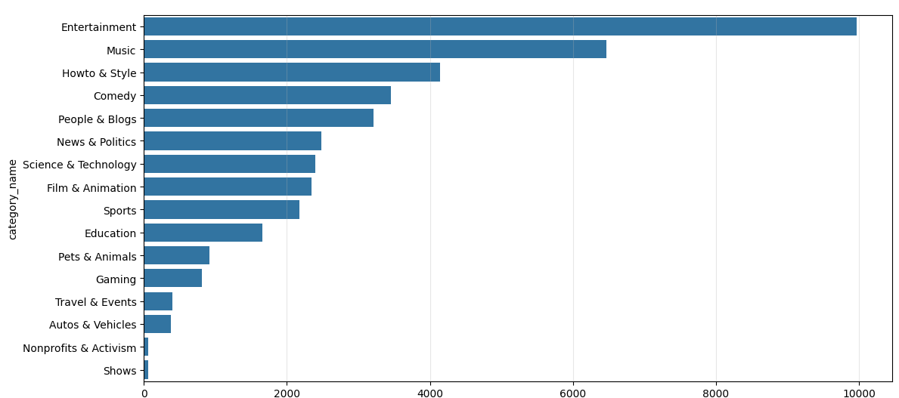
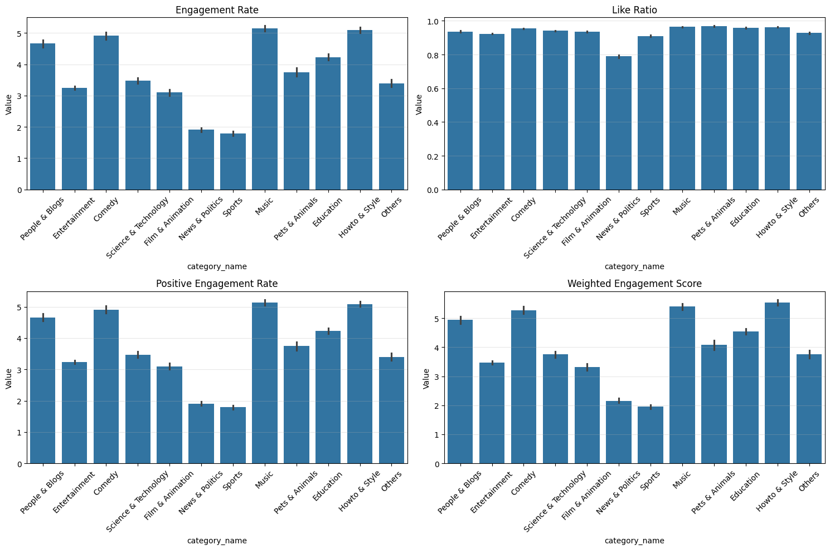
Hallazgos del EDA y Distribuciones
Análisis de Distribución
Y Engagement
Las categorías predominantes son:
Entertainment (24,3%)
Music (15,8%)
Howto & Style (10,1%)
Las categorías como Music y Howto & Style tiene las tasas de engagement más altas sugiriendo que los usuarios interactúan activamente con un contenido informativo y artístico

Slide 5
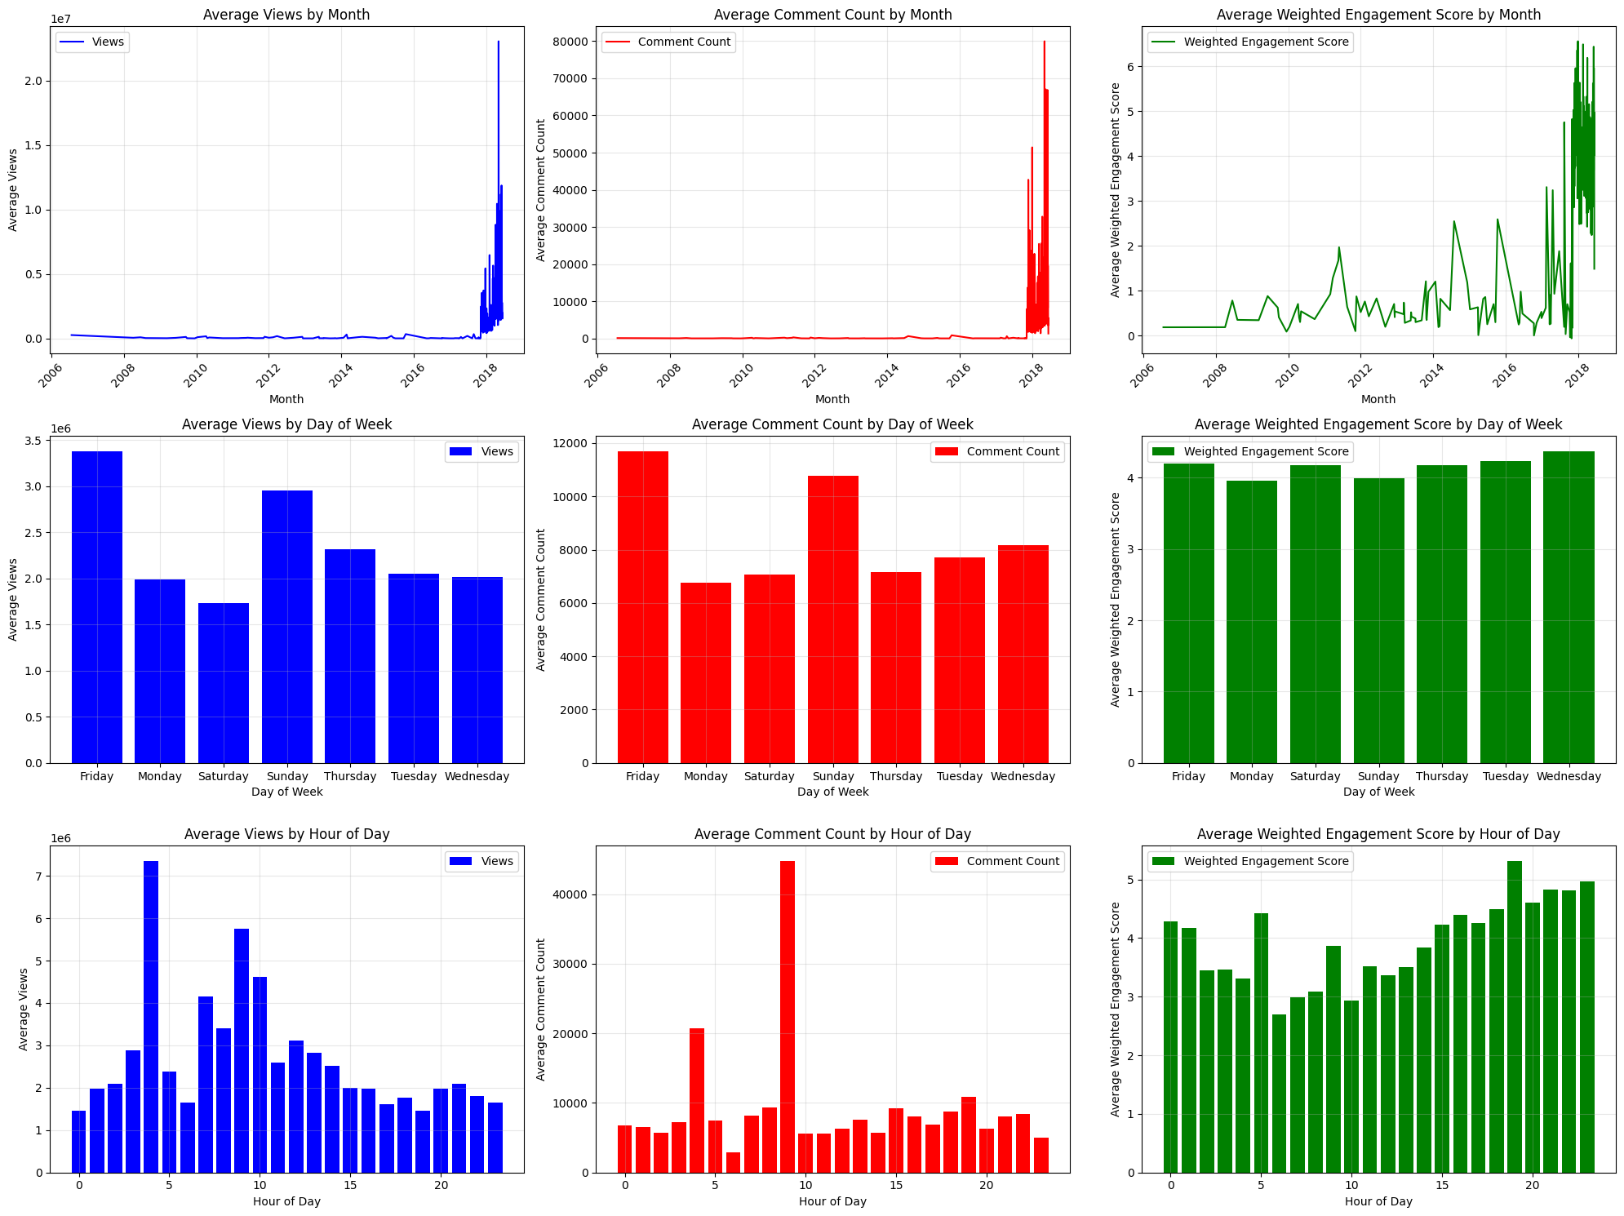
ANOVA
El análisis ANOVA reveló que tanto el día, la hora y la fecha de publicación influyen significativamente en la visibilidad y el engagement, lo que apoya el uso de estos atributos temporales para el desarrollo de modelos predictivos
Hallazgos del EDA y Distribuciones
Hallazgos de correlaciones y ANOVA
El análisis de correlación indicó relaciones fuertes entre variables clave
Views, Likes y comentarios mosrtarón correlaciones positivas significativas, lo que indica la relevancia de las interacciones iniciales para promover difusión y engagement

Slide 6
Análisis de Clustering
Clustering y Atributos Clave
Slow Burner
Alcance superior al promedio, interacción promedio • Tardan aproximadamente 24 días en generar interés • Se publican mejor al final del día
Afternoon Steadies
K-Means:
Se identificaron 8 clusters distintos, cada uno con características únicas respecto a engagement y temporalidad de publicación.
DBSCAN
Identificamos múltiples clusters pequeños y un gran grupo de outliers, sugiriendo que gran parte del contenido posee características muy especificas
Visualizaciones e interacción de rango medio • Tendencia en aproximadamente 2 semanas • Caídas principalmente por la tarde
Rapid Engagers
Mid-Tier Warmers
Alcance moderado, pero la mayor interacción • Se convierten en tendencia en menos de 7 días • Distribuidas en franjas horarias de MP
Buen alcance e interacción • Tendencia en ~15 días • Publicaciones en PM divididas uniformemente
Morning Blockbusters
Mayores visualizaciones sin procesar, alta tasa de "me gusta" • Interacción moderada • Tendencia en ~2 semanas
Low Performers
Steady Late-Trenders
Alcance más bajo y tasa de "me gusta" más baja • Tardan casi un mes en ser tendencia • Publicaciones solo por mensaje privado
Alcance de rango medio, alta interacción • Tendencia en ~3 semanas • Principalmente publicaciones por la tarde
Afternoon Quick Hits
Visualizaciones e interacción equilibradas • Gran éxito en ~12 días • Casi la mitad de las publicaciones llegan por la tarde

Slide 7
Clustering y Atributos Clave
Importancia de
Atributos clave
Estos hallazgos refuerzan la importancia de centrarse en generar contenido atractivo que estimule una interacción positiva inmediata y de alta calidad por parte de la audiencia. Los modelos predictivos deben priorizar variables relacionadas con engagement (like_ratio y weighted_engagement_score) y la velocidad para alcanzar tendencia, mientras que las variables temporales diarias pueden tratarse como complementarias, pero no centrales, para mejorar la precisión predictiva.
#1
Like_ratio
42,9%
#2
Weighted_engagement_score
42,27%
#3
Days_until_trending
13,28%
#4
Temporalidad del dia
0,3% - 0,4%

Slide 8
Modelos Predictivos y Performance
Modelo
Predictivo
Para este proyecto se encontró que el modelo de Random Forest es el modelo más efectivo para predecir las vistas dados los parámetros iniciales. Captura patrones complejos sin un ajuste excesivo
Regresión Lineal
Random Forest
XGBoost
MAE (M)
2.644
MAE (M)
1.548
MAE (M)
2.138
RMSE (M)
7.230
RMSE (M)
4.350
RMSE (M)
5.646
R²
0,067
R²
0.652
R²
0.412

Slide 9
Modelos Predictivos y Performance
Purpose &
Goal
Description
A wonderful serenity has taken possession of my entire soul, like these sweet mornings of spring which I enjoy with my whole heart. I am alone, and feel the charm of existence in this spot
I am so happy, my dear friend, so absorbed in the exquisite
I am so happy, my dear friend, so absorbed in the exquisite sense of mere tranquil
Our vision
Short term plan
A wonderful
Long term plan
A wonderful serenity has taken possession of my soul

Slide 10
Thank
You
A wonderful serenity has taken possession of my entire soul, like these sweet mornings
Visit here
www.yourwebsite.com

Slide 11
Timeline history
A wonderful serenity has taken possession of my entire soul, like these sweet mornings of spring which I enjoy with my whole heart. I am alone, and feel the charm of existence in this spot, which was created for the bliss of souls like mine. I am so happy, my dear friend, so absorbed
Our Journey
2018
2019
2020
2021
A wonderful serenity has taken detail
A wonderful serenity has taken detail
A wonderful serenity has taken detail
A wonderful serenity has taken detail

Slide 12
We’ve best services
Great place
Great place
Great place
A wonderful
A wonderful
A wonderful
3.534 (points)
8.452 (points)
4.227 (points)
Description
Description
Description
A wonderful serenity has taken possession of my entire soul
A wonderful serenity has taken possession of my entire soul
A wonderful serenity has taken possession of my entire soul

Slide 13
Meet the
team
A wonderful serenity has taken possession of my entire soul, like these sweet mornings of spring which I enjoy with my whole heart. I am alone, and feel the charm of existence in this spot

Slide 14
Meet the expert
Edward George
Thomas Duo
Malvin Steward
Max Braven
Founder company
Co-founder
Business marketing
Staff leader

Slide 15
Meet the team
Meet the
community
A wonderful serenity has taken possession of my entire soul, like these sweet mornings of spring which I enjoy
Social media
A wonderful serenity has taken
The team
A wonderful serenity has taken possession of my soul
A wonderful

Slide 16
Meet the team
Meet the
professional
A wonderful serenity has taken possession of my entire soul, like these sweet mornings of spring which I enjoy with my whole heart. I am alone, and feel
Meeting time
23.412

Slide 17
Project
Portfolio
A wonderful serenity has taken possession of my entire soul

Slide 18
Portfolio design
Our new
latest project
A wonderful serenity has taken possession of my soul
Description
Description
A wonderful serenity has taken possession of my soul
A wonderful serenity has taken possession of my soul

Slide 19
Project Detail
Description
Creator
A wonderful serenity has taken possession of my entire soul, like these sweet mornings of spring which I enjoy with my whole heart.
A wonderful serenity has taken possession
Edward George
Founder company
Points
Social media
+23.534
Project portfolio description
Details

Slide 20
Project portfolio
All collection
portfolio
A wonderful serenity has taken possession of my entire soul, like these sweet mornings of spring which I enjoy with my whole heart. I am alone, and feel the charm of existence in this spot, which was created for the bliss of souls like mine.
www.yourwebsite.com

Slide 21

Project showcase
Mobile site use tablet
A wonderful serenity has taken possession of my entire soul, like these sweet mornings
01.
Easy access
02.
Responsive display
03.
Good design
04.
Elegant design
05.
Accesoriess

Slide 22
Diagram & Infographic
Diagram &
Infographic
A wonderful serenity has taken possession of my entire soul, like these sweet mornings of spring which I enjoy with my whole heart. I am alone, and feel

Slide 23
Line chart diagram
Detail information
A wonderful serenity has taken possession
2018
2021
2.0 pts
6.0 pts
2019
2022
4.0 pts
5.0 pts
2020
2023
3.0 pts
7.0 pts

Slide 24
Pie chart diagram
Description
Primary data
A wonderful serenity has taken possession of my entire soul, like these sweet
25%
Second data
Description
26%
A wonderful serenity
Third data
Description
49%
A wonderful serenity
A wonderful serenity has taken possession of my entire soul, like these sweet mornings of spring which I enjoy with my whole heart.

Slide 25
Structural diagram
Threat
A wonderful serenity has taken possession of my entire soul
Strength
A wonderful serenity has taken possession of my entire soul
Weakness
Opportunity
A wonderful serenity has taken possession of my entire soul
A wonderful serenity has taken possession of my entire soul

Slide 26
Diagram & infographic
Edit document
Diagram &
Infographic
Validate document
Scan document
A wonderful serenity has taken possession of my entire soul, like these sweet mornings of spring which I enjoy with my whole heart. I am alone, and feel
Check data
Detail information
A wonderful serenity has taken possession
Scan
Validate
Finish
Check
Edit

Slide 27
International map
Description
A wonderful serenity has taken possession
Description
A wonderful serenity has taken possession
Description
Description
A wonderful serenity has taken possession
A wonderful serenity has taken possession

Slide 28
Pricing table
BASIC
STANDARD
PREMIUM
12
35
59
$
$
$
/MO
/MO
/MO
Good quality product
Good quality product
Good quality product
50+ category product
50+ category product
50+ category product
_
Customable design
Customable design
_
_
Modern & minimalism

Slide 29
Testimonial
People
Feedback
A wonderful serenity has taken possession of my entire soul, like these sweet mornings of spring which I enjoy with my whole heart. I am alone, and feel
Edward George
Edward George
Founder company
Founder company
“A wonderful serenity has taken possession of my entire soul, like these sweet mornings”
“A wonderful serenity has taken possession of my entire soul, like these sweet mornings”

Slide 30
Visit us here:
www.yourwebsite.com
Phone
Contact us
+51 512 6247 1235
+86 236 1124 6775
Email address
yourMessage@email.com

